Slide 1
SUMMER TRAINING PROJECT REPORT
ENTERPRISE RETAIL INTELLIGENCE SYSTEM
Oracle SQL Relational Warehousing, RFM Feature Engineering, and Unsupervised K-Means Machine Learning.
Submitted by: Ayush Raj (Reg. No: 12315673)
Course / Mentor: CSE343 | Avinash Kaur Mam
Institution: School of Computer Science & Engineering, LPU
Lovely Professional University
Academic Session 2025-2026

Slide 2

Introduction
Institutional Background & Project Objectives
Lovely Professional University
Chapter 1: Introduction

Slide 3

Context & Core Objectives
Business Problem
Project Objectives
Modern enterprise retail platforms generate massive transaction logs containing missing records and varied pricing.
Architect a normalized Star Schema with Fact and Dimension tables enforcing strict integrity.
Compile automated row-level PL/SQL triggers for dynamic line spend calculation.
Standard transactional tables cannot identify at-risk customers or distinguish high-value shoppers without automated calculation triggers, feature normalization, and machine learning segmentation.
Aggregate raw data into 3D customer RFM (Recency, Frequency, Monetary) vectors.
Train unsupervised K-Means clustering models to segment shoppers.
Lovely Professional University

Slide 4






Decoupled System Architecture
Presentation Layer
Analytical & ML Layer
Persistent Storage
Multi-platform rendering featuring a Streamlit Web Dashboard and a standalone Tkinter Desktop GUI for real-time visual analytics and KPI tracking.
Engineered Python pipelines for RFM feature extraction, mathematical Z-score normalization via StandardScaler, and unsupervised K-Means clustering.
Relational storage utilizing Star Schema architecture (Fact/Dim tables) managed by SQLite, supplemented by robust CSV export pipelines.
Lovely Professional University

Slide 5


Database Engineering & PL/SQL
Star Schema Integrity
The schema maintains clear boundaries between master entities (Customers, Products) and transactional facts. To guarantee consistency without application overhead, we deployed automated database triggers.
CREATE OR REPLACE TRIGGER trg_calc_total BEFORE INSERT ON fact_transactions FOR EACH ROW BEGIN :NEW.total_amount := :NEW.quantity * :NEW.unit_price; END;
Lovely Professional University
Database Engineering

Slide 6






Feature Engineering (RFM Model)
Recency (R)
Frequency (F)
Monetary (M)
Calculated as the total number of days elapsed since the customer's last recorded transaction date.
Aggregated distinct count of unique invoice numbers associated with each individual customer ID.
The absolute sum of total spend across the entire customer lifetime value (CLV) history.
Lovely Professional University

Slide 7



Machine Learning Pipeline
Standardizing Scale Dominance
Because 'Monetary' values range in the thousands while 'Recency' operates in single days, raw Euclidean distance calculations in K-Means become distorted.
Z-Score Formula
We applied Z-score standardization (StandardScaler) to mathematically normalize the distributions, assigning equal weight to all three RFM dimensions before clustering.
Lovely Professional University

Slide 8

System Performance & KPIs
$121,314
Robust Pipeline Execution
The automated ETL pipeline successfully ingested, cleaned, and processed the raw dataset, isolating viable customer records and filtering out invalid transactions (e.g., negative quantities or missing IDs).
TOTAL REVENUE PROCESSED
The K-Means clustering algorithm successfully separated the customer base, achieving a validated mathematical Silhouette Score of 0.3789, indicating statistically significant cluster boundaries.
2,733
TOTAL INVOICES HANDLED
Lovely Professional University

Slide 9
Customer Segment Cohorts
Customer Segment | Population | Strategic Business Profile
Mid-Tier / Potential Loyal | 1,412 | Moderate recency and order frequency; identified as the ideal target base for product cross-selling initiatives.
Low Value / Hibernating | 1,277 | High recency (inactive) with low cumulative spend; primary targets for automated email re-engagement campaigns.
High Value / Champions | 641 | Highest spend and frequent orders; prime candidates for VIP loyalty perks and early access programs.
Lovely Professional University

Slide 10
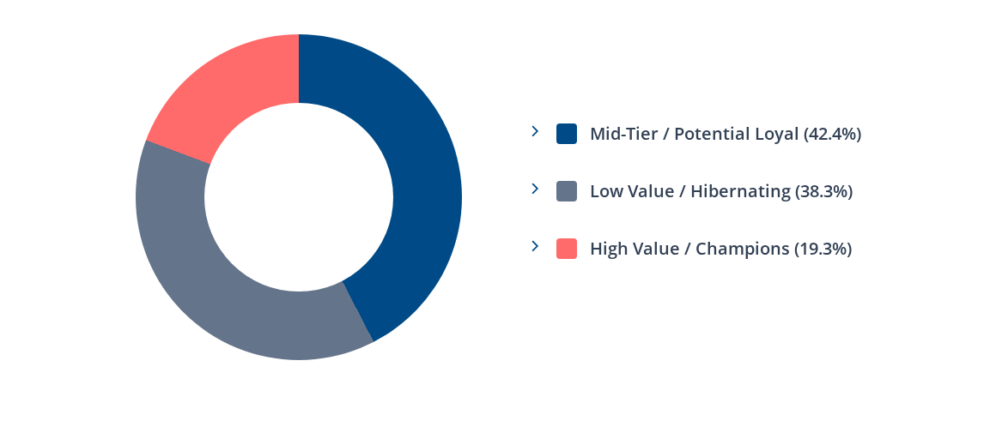
Cohort Distribution Proportions
Lovely Professional University
Distribution Proportions

Slide 11
Technical Challenges & Solutions
Feature Scale Dominance Monetary spend ranged in thousands while Recency ranged in days, heavily distorting Euclidean distance metrics. This was successfully mitigated using Scikit-Learn's StandardScaler.
OS File Locking (Windows) Concurrent file reads/writes triggered PermissionErrors during ETL execution. We engineered robust path fallbacks and enforced in-memory data execution to bypass OS-level locks.
UI Thread Latency Live model retraining severely lagged the Streamlit dashboard rendering. We resolved this by decoupling the heavy batch training pipeline from the frontend visualization components.
Lovely Professional University
Challenges & Solutions

Slide 12

Conclusion & Future Scope
The system successfully bridges relational database engineering, RFM feature transformation, and Unsupervised K-Means clustering into a cohesive enterprise solution.
Roadmap
Automate dynamic K-selection via programmatic Elbow sweeps.
Scale warehouse architecture to Snowflake/PostgreSQL.
Integrate XGBoost for supervised churn prediction.
Thank You
Ayush Raj | Reg. No: 12315673 | CSE343
Lovely Professional University

